Slide 1
Konglish vs English
Do you know the difference?

Slide 2
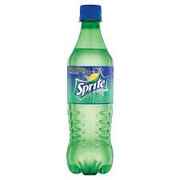


Is this called cider (사이다) in English?
No, this drink is called Sprite which is equivalent to cider!

Slide 3
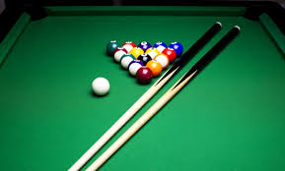

Is this game called pocket ball(포켓 볼) in English?
No, this game is called pool!

Slide 4
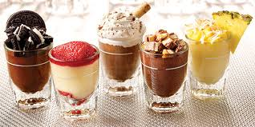

Is this called dessert (데서트) in English?

Slide 5
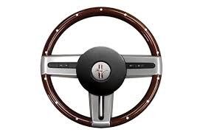
Is this called handle (핸들) in English?
No, this is called a steering wheel!

Slide 6
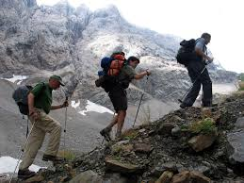
Is this called hiking (하이킹) in English?

Slide 7
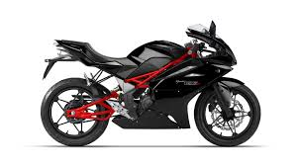

Is this called autobi (오토바이) in English?
No, this is called a motorbike or motorcycle!

Slide 8
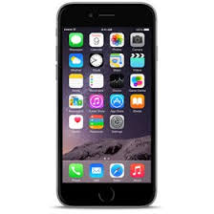
Is this called hand phone(핸드폰) in English?
No, this is called a cellphone (US) or mobile phone (UK)!

Slide 9
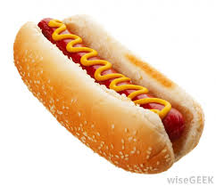
Is this called hot dog (핫도그) in English?

Slide 10

Is this called one room (원룸) in English?
No, this is called a studio apartment!

